Slide 1
WEB DESIGNING PROJECT

Slide 2
Group Members
Daham Aloka
Amaya Sarini
Shasheen Kaushika
Admi Chamika
Tharushi Dhananjana
Hasith Nelum
Gimhan Dileesha
Hasangi Chamathsara
Sanura Sachintha

Slide 3
MT HOSPITAL SERVICE

Slide 4

INTRODUCION
MT Hospital service is a leading hospital network in London. They offer the following service for their
  Primary care service
  Mental health and drug treatment
  Infectious diseases clinics
  Hospital care
  Dental service
  Surgeries and other service

Slide 5
Problem statement
Hospital getting crowded and filled with people
Miscommunication occurs with the doctors and between the patients
When it comes to meeting a doctor it is not easy to meet the required doctor that who we want
Not very much accurate and timewasting.

Slide 6

Goal
To promote the MT hospital service and give a better idea about the hospital.

Slide 7
How did we reach for our goals ?
Designing the webpage very accurately and user-friendly
Using a GUI friendly web design for the webpage
Providing all the information up to date and very accurately
Creating the webpage, easy to communicate with the doctors and contact them

Slide 8
Requirements
To communicate accurately
To reserve doctors as anyone hope
To get information about MT hospital service
To patients facility
To promote the hospital service

Slide 9
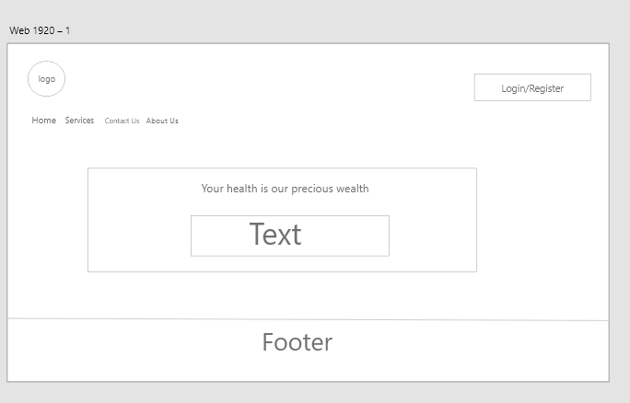
Wire Frame

Slide 10
Interface

Slide 11
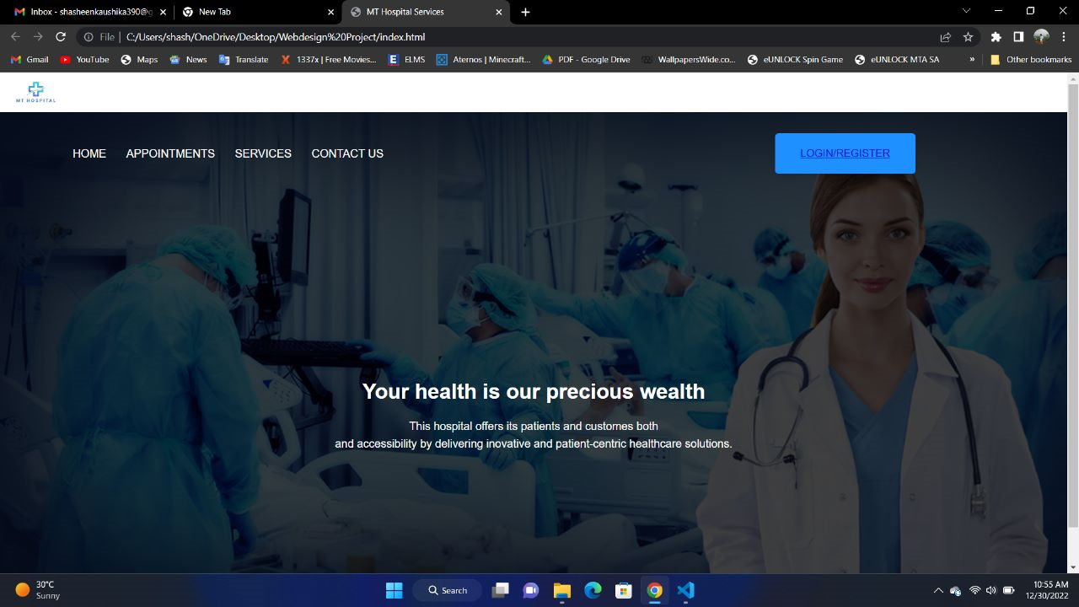

Slide 12
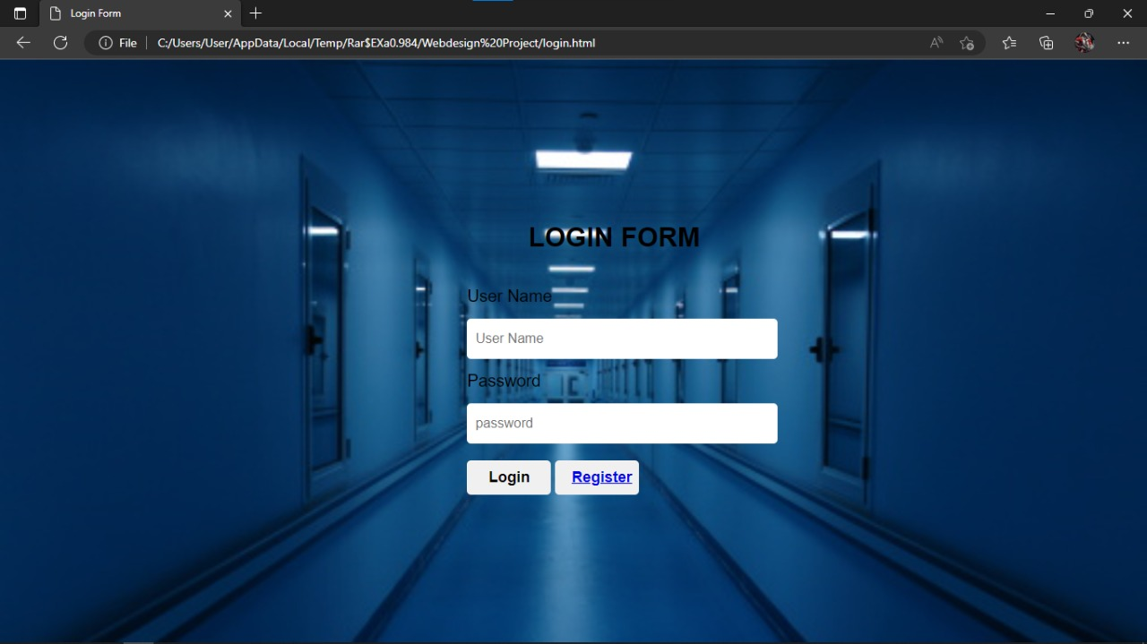
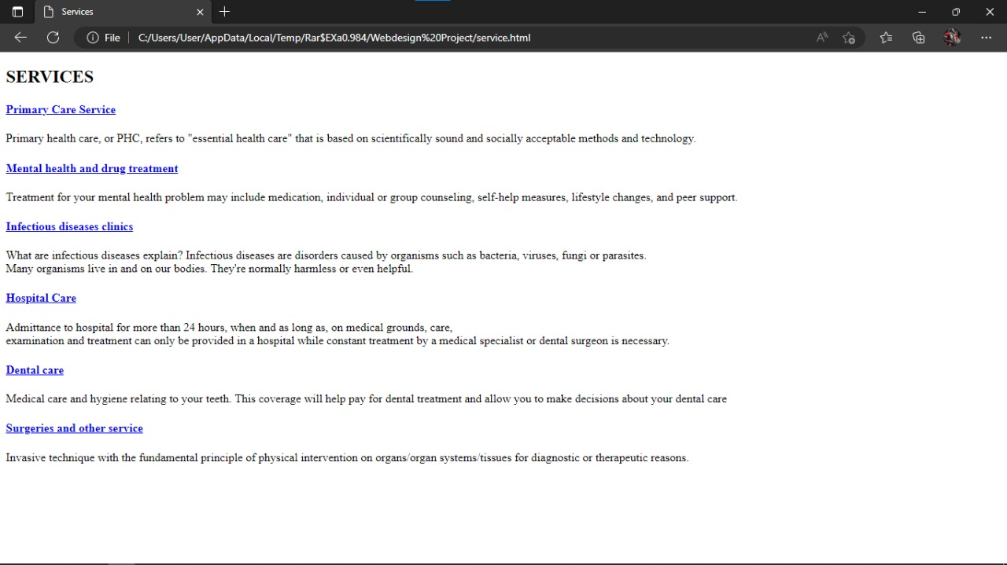

Slide 13
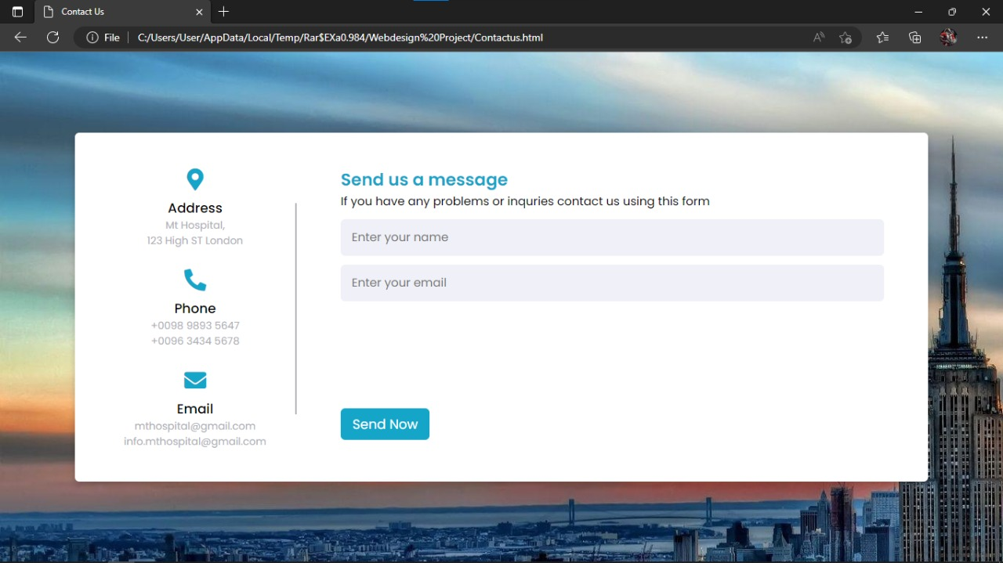
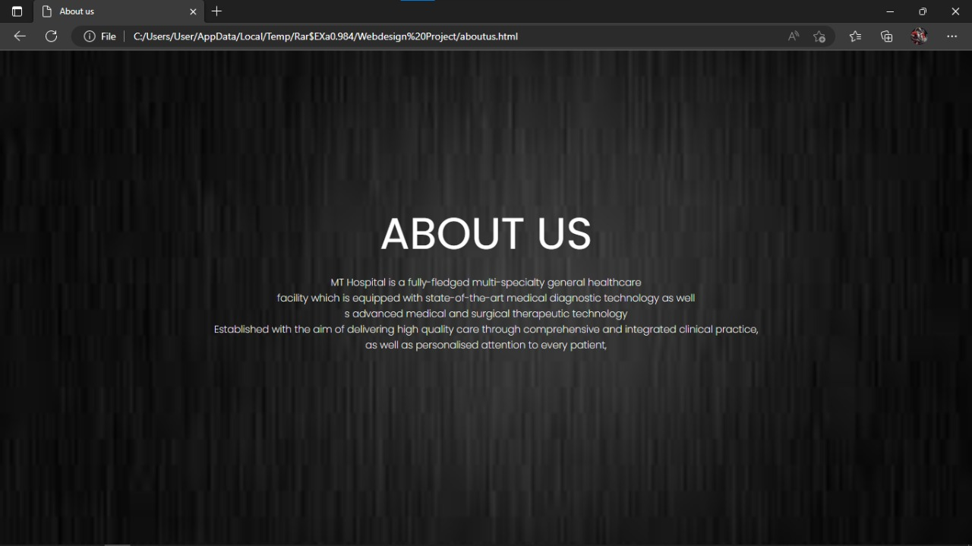

Slide 14
Conclusion
We create this to give better ideas about MT Hospital as well as
thanks for listening and have a nice day!!!

